Slide 1


Slide 2

Who Watches the Watchmen
Introducing a Better Metric of your Tests’ Quality
Matthew Knowles
Software Engineer at Emmersion Learning
www.EmmersionLearning.com
@MatthewYKnowles
Matthew.Knowles@EmmersionLearning.com

Slide 3
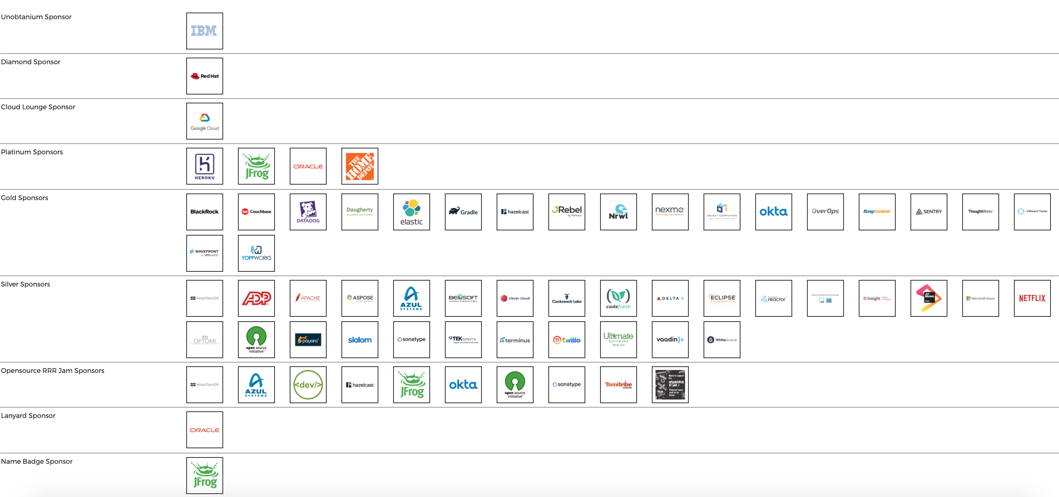

Slide 4
Tests
Notes:
We are going to talk a lot today about specific types of tests but lets first start zoomed out and ask why do we write tests? What reasons do y’all have for writing tests?

Slide 5
Why Write Tests?
Verify functionality
Defend against unexpected change
Executable documentation of the code
Notes:
These are generally the reasons I hear for writing tests.
Executable documentation of code is maybe an outlier here but what I mean by that is if someone asked me what the features are in my current I would immediately look to the UI/E2E testing suite and start reading off test names.
You can login create a support ticket and receive a confirmation email
You can login upload a log file
You can login and download the latest version of the software

Slide 6
What is driving more companies to adopt automated testing?
Notes:
More and more companies are starting to embrace automated testing and are thinking about testing earlier and earlier in the development cycle.
Just because I am interested - how many people in here practice Test Driven Development at their job?

Slide 7

Notes:
How many of you have read this book?
Does anyone remember what the 4 “Key Metrics of Success” were?

Slide 8
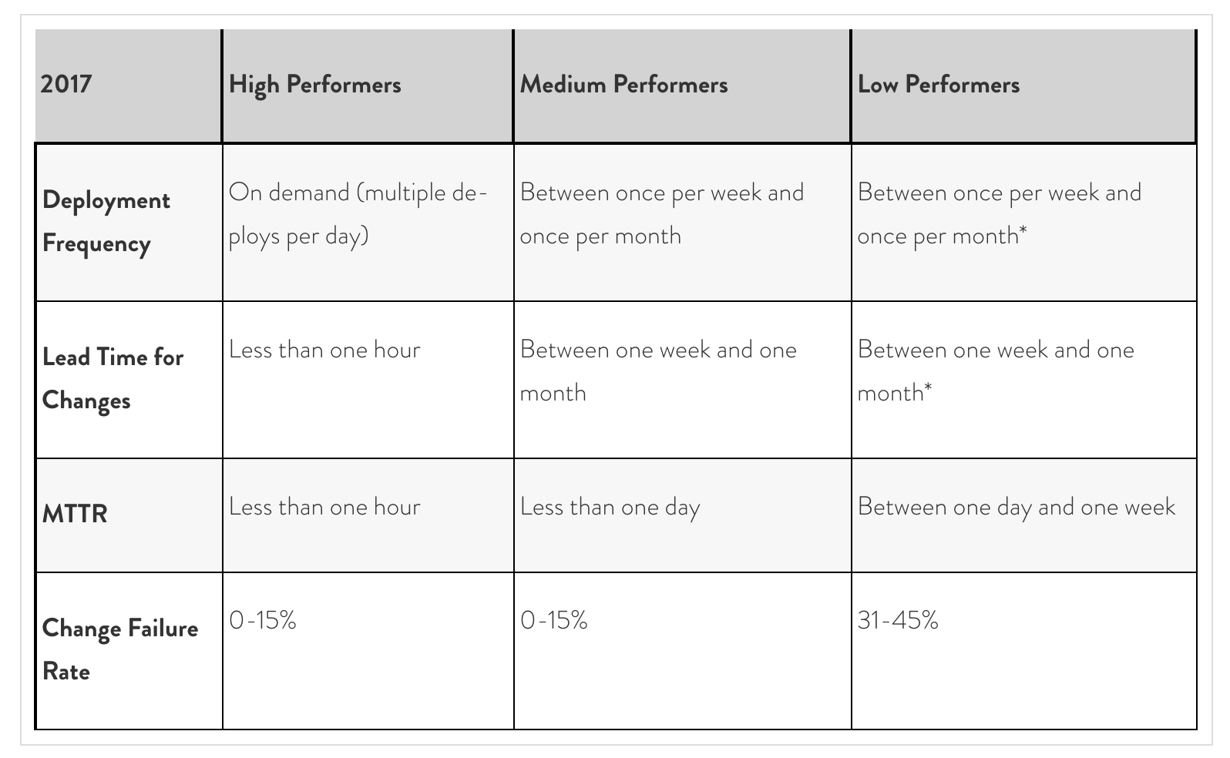
Notes:
The findings of Accelerate can basically be summed up to the best measurable predictor of team success is how they perform on these ”4 Key Metrics”
What does this have to do with the quality of my test suite?
As teams are trying to move into that “High Performers” category they have to start deploying multiple times a day which can pretty quickly overwhelm a manual QA team.
Lead time for changes general decreases if you can make a fix, run your tests, and if they pass confidently deploy to production.
Mean Time to Recovery is more indictive of the quality of your DevOps and how quickly you can roll back a deploy
Change Failure Rate should decrease as the quality of your test suite increases

Slide 9
How is a test suite’s quality measured?
Notes:
How do you know how good your tests are? How confident are you that mistakes in the code will get captured by your tests? Do you currently have a way to measure the quality of your tests? What do you use?

Slide 10
Code Coverage
Notes:
A lot of companies would say code coverage is their metric of test quality. Lets take a look at a code coverage analysis and see what it looks like

Slide 11
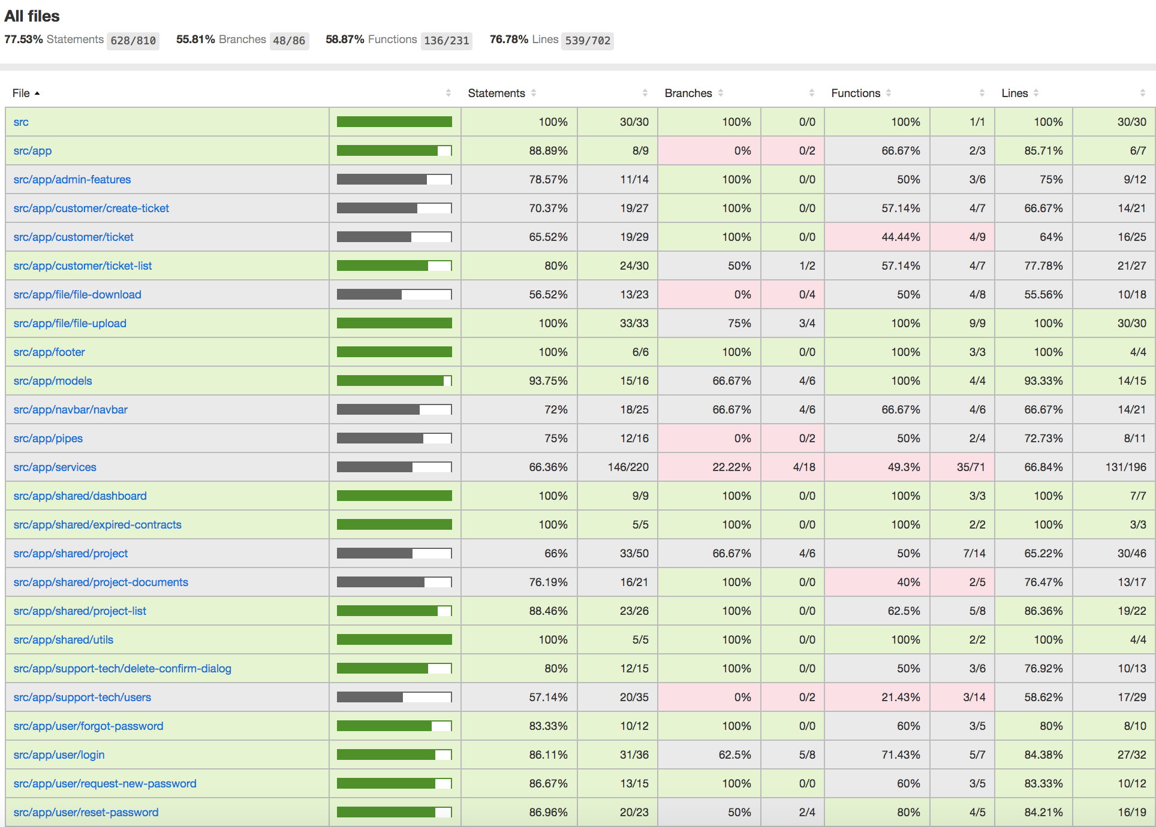
Notes:
This a coverage analysis a project in JavaScript. Is this a good amount of coverage? What amount of coverage would make you feel confident in the quality of your test suite?

Slide 12
How is code coverage calculated?
Notes:
Does anyone know how code coverage is calculated? What does it mean to have 100% code coverage?

Slide 13
What are implications for the quality of the tests?
Notes:
I will get into some of the shortcomings of code coverage with a coding demo in a few minutes but the way that we use code coverage at my company is not to know what code already has high quality tests but instead as an indicator of what code is not tested. If I have code that is 80% covered then I know for sure that 20% of the code does not have tests verifying the logic.

Slide 14
What does 100% code coverage mean?
Notes:
Does having high coverage itself give you confidence to deploy to your customer?

Slide 15

Adding Functionality to Legacy Code
Code Coverage
Limitations of Code Coverage
Mutation Testing
https://github.com/MatthewYKnowles/Refactoring-Exercise-Rentals

Slide 16
Mutation Testing
Notes:
Which brings us to mutation testing
The idea is to really exercise your test suite and see how well it covers you from changes in functionality
The way that it achieves this is by going into your code and fundamentally changing the functionality and then running your tests
Hopefully with changed functionality at least one test fails.

Slide 17
How would you mutate this code?
1. a < b
2. a || b
3. a == b
4. if(a > b) {return a+b}
5. if(b > a) {a++}

Slide 18


Slide 19
If mutation testing is so awesome, why has no one heard of it?
Notes:
Very Computer Intensive – Using multiple cores at the same time
For Every Mutation must rerun entire test suite
With more time in between deploys automated testing was not as important
Whats changed
Basic computers have many cores to simultaneously run test suites
Running coverage analysis before mutation testing to figure out which tests to execute
Teams are deploying code more often and relying more on their automated test suites

Slide 20
When is mutation testing useful?
Notes:
When jumping into legacy code and you don’t know the quality of the tests.
Very computationally heavy parts of the code – talk about scoring algorithm at Emmersion.
Just finished writing a critical feature that would be expensive if it accidentally broke – talk about how this does not apply to Facebook
Probably don’t run mutation testing in CI/CD

Slide 21

As hard-nosed as I am about TDD as a necessary discipline; if I saw a team using mutation testing to guarantee the semantic stability of a test-after suite; I would smile, and nod, and consider them to be highly professional. (I would also suggest that they work test-first in order to streamline their effort.)
-Robert Martin (Uncle Bob)

Slide 22
Mutation Testing Frameworks
JavaScript – Stryker
Java – Pitest
C# - Stryker and Visual Mutator

Slide 23
Questions?
Further Reading:
Filip van Laenen – Mutation Testing: Better Code by Making Bugs
Martin Fowler – Refactoring
@MatthewYKnowles

